Slide 1
CLASSIFICATION
TRAINING TEMPLATE

Slide 2


LEARNING OUTCOMES
On completion of this module, you will understand:
Learning objective 1
Learning objective 2
SLIDE # OF $\#$

Slide 3

LEARNING TOPIC
SUBTITLE
Introduction text for the slide.
Text font:
List details.
List details.
List details.
List details.
Let’s explore these concepts further on the next slide….
SLIDE # OF $\#$

Slide 4
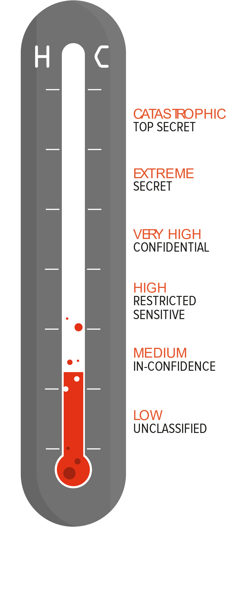
Developing Learning Scenarios
When developing your own learning scenarios, use scenarios that apply the learnings from the online modules and are indicative of the types of information your organisation handles on a regular basis.
The following two scenarios as base examples for developing your own set of scenarios.
QUESTION # OF #

Slide 5
Scenario A
Workshop Attendees List
A government agency runs a series of regional workshops on construction safety and collect the names and contact details of everyone who attends.
Attendees are predominantly health and safety managers in construction firms or other health and safety professionals. As part of the registration process, attendees consented to have their names and locations shared across the health and safety community.
Classification decision
Carlo works for the government agency and wants to classify this information. He believes that there is no risk of real harm if the list was released so he is happy it is not SENSITIVE. However, he knows that the release of people’s personal information can cause trouble and is considering classifying the document as IN-CONFIDENCE.
Is this correct?
This information can be marked as UNCLASSIFIED. All individuals have privacy rights that are defined in the Privacy Act 2020 and must be protected accordingly. Not all personal information requires classification to increase protections beyond the standard protections applied to all personal information. Compromise of this information is unlikely to result in a privacy breach.
Answer the following questions in relation to the scenario described on the right.
Assess the potential harm of disclosure
Which classification category does this information fit within? (Privacy and Policy, or National Security)
What protective marking should it have?
Who can have access to it?
How should the information be securely handled? (e.g. when creating, editing, transporting, sharing, or destroying the information?)
QUESTION # OF #

Slide 6
Scenario B
Investigation Record
A whistleblower alleged to the agency’s finance manager that an individual currently working for the agency was committing financial fraud. An investigation file was opened to ascertain the validity of the claim.
Classification decision
The staff member creating the investigation file is clear that release of this information would, at the least, cause distress and that it should be at least IN-CONFIDENCE.
However, given the nature of the information the staff member agreed with the manager that it should be classified as SENSITIVE.
Are they right?
Yes. It is reasonable to assume that the release of this information could harm someone’s well-being. On the basis of the harm test, this information should be SENSITIVE.
Answer the following questions in relation to the scenario described on the right.
Assess the potential harm of disclosure
Which classification category does this information fit within? (Privacy and Policy, or National Security)
What protective marking should it have?
Who can have access to it?
How should the information be securely handled? (e.g. when creating, editing, transporting, sharing, or destroying the information?)
QUESTION # OF #

Slide 7
Visual Resources
We’ve provided the following graphic resources from the materials developed for the Classification Programme.
For high quality photos we
recommend the following websites:
www.unsplash.com
www.pexels.com
www.flickr.com

Slide 8

Content Page / #FFFFFF Background
CHECK IN / 15pt Heavy / #005F84
Title / 32pt / #005F84
TITLES #20A2BB
Text Intro #000000 16pt
Text content #000000 16pt.
Introduction Page / #DBE3E8 Background
Example #198094 13pt
TITLE #1C8CA1
Links 11pt #198094
Popup links #BA340D
Further information text #BA340D 9pt.
Title Page / #143144 Background
CONTINUE #005F84
TITLE // #21A5BE
BACK

Slide 9



















Visual Resources

Slide 10

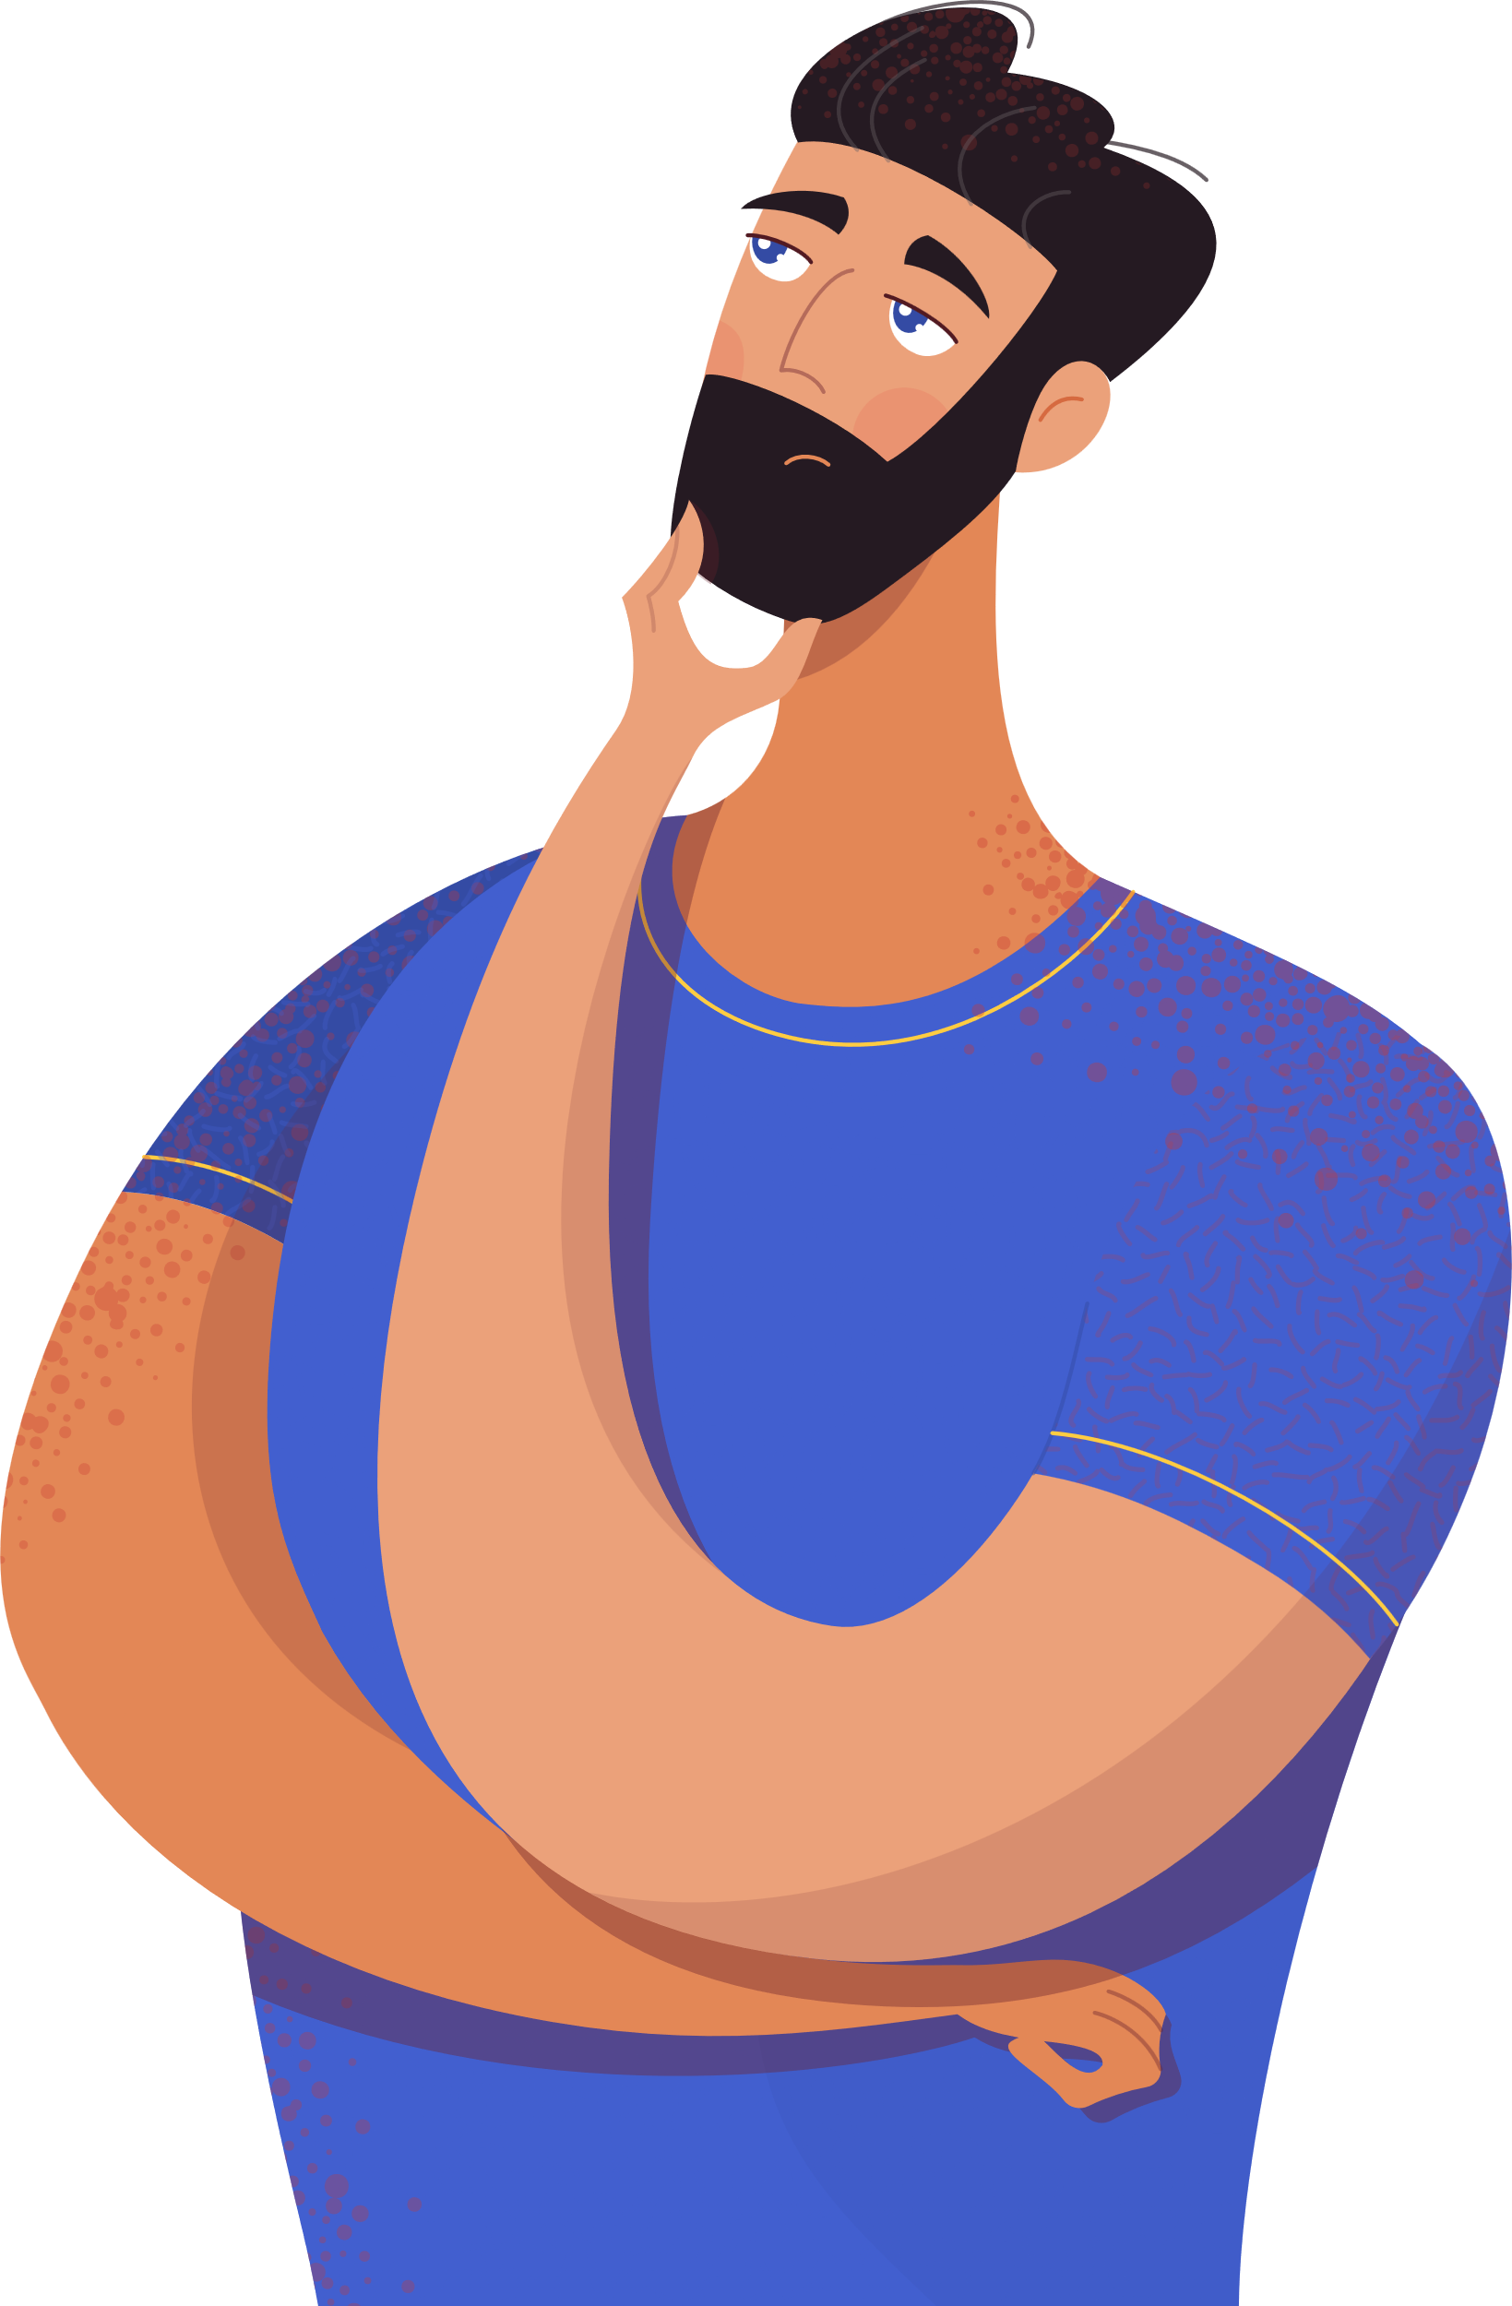

Visual Resources

Slide 11
Visual Resources

Slide 12
Security Breach examples

Slide 13

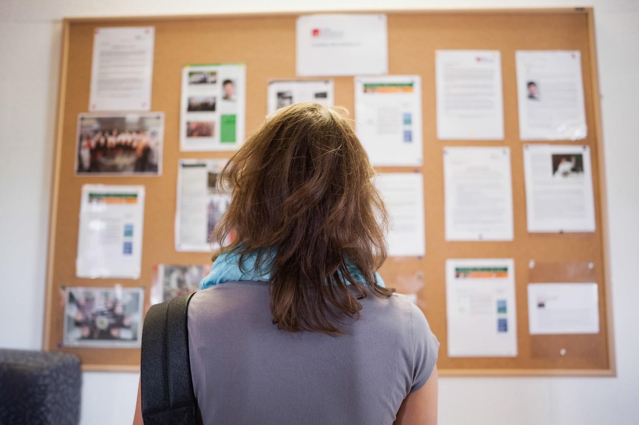
SECURITY BREACH EXAMPLE #1
Privacy
Breach
Two parents complained to the Privacy Commissioner after a primary school displayed
their child’s Medical Action Plan (MAP) in the
school staffroom.
The parents were worried that their child’s dignity would be compromised if the information was viewed by other classmates and risks of being bullied.
The Privacy Commissioner concluded that the school had breached principle 5 of the Privacy Act. Given the extremely sensitive nature of the child’s medical condition, the Privacy Commissioner did not believe the staffroom was the appropriate location to display the MAP.

Slide 14
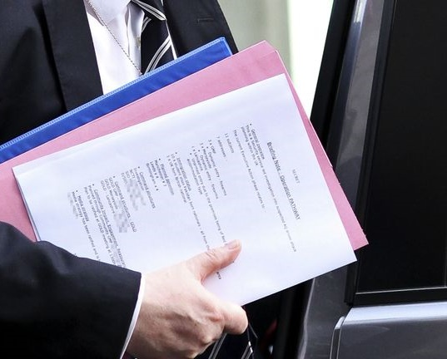
SECURITY BREACH EXAMPLE #2
Security
Blunder
Bob Quick (UK Anti-terror Chief) compromised Operation PATHWAY when he existed a vehicle holding classified information in plain view which was photographed by a reporter.
Because of his blunder, anti-terror raids in Manchester and Liverpool had to be brought forward by several hours, and according to senior sources were "compromised".

Slide 15
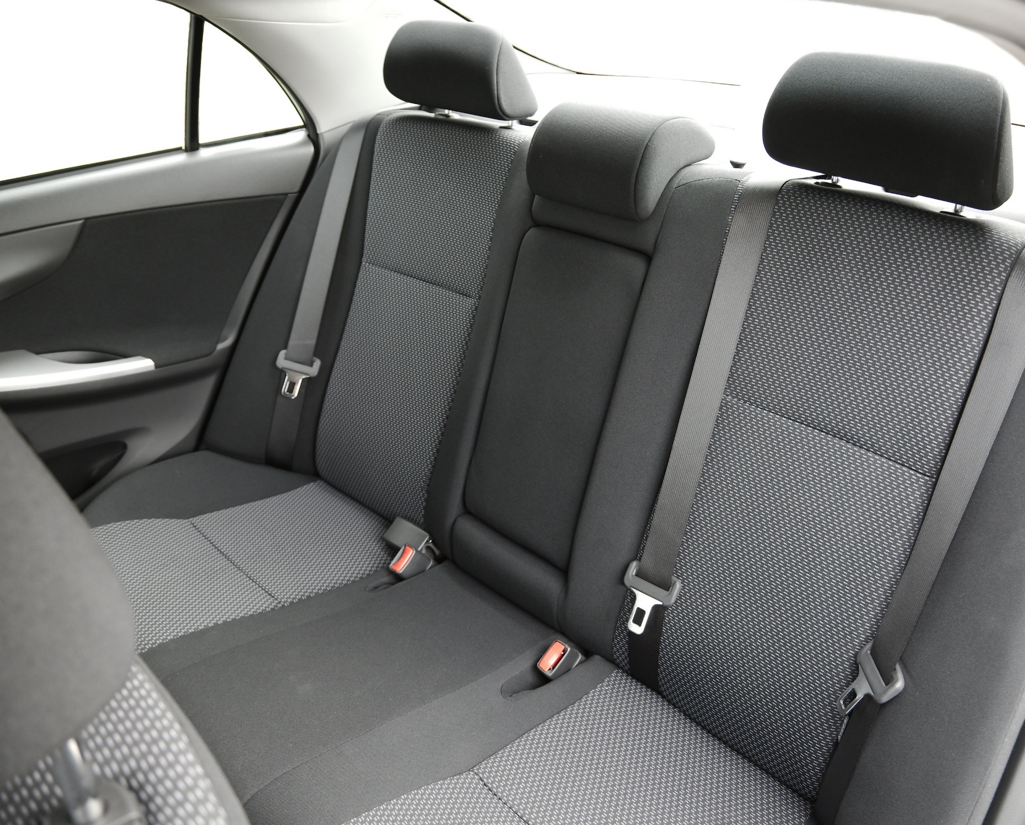
SECURITY BREACH EXAMPLE #3
Stolen Documents
Restricted military documents were
stolen from an unlocked car.
Classified military documents including a security check-list and standing orders were stolen after being left in a rubbish bag in an unlocked car.
The vehicle was left unlocked while he went back inside for more possessions. When he returned, the bags were gone.

